Slide 1

Risks and Benefits of Migrating a Security Operations Center to the Cloud
Dr. Viktor Polic
CISO, International Labour Organization
Adjunct faculty, Webster University Geneva

Slide 2
Disclaimer
The views expressed herein are those of the author and do not necessarily reflect the views of the International Labour Organization.

Slide 3
Business case
How many SOCs your organization has?
How are they coordinated?
What are data exchange requirements?
Is this linked to log management system?
Are they managed SOCs?
Where are they?
How big is your security team?
Can you quickly find skilled people?
ISMS
End-point SOC
Perimeter level SOC
Data centers SOC
Communication SOC

Slide 4
Market analysis
“By 2022, 50% of all SOCs will transform into modern SOCs with integrated incident response, threat intelligence and threat hunting capabilities, up from less than 10% in 2015.”
Gartner
Gartner defines a SOC characteristically as both a team, often operating in round-the-clock shifts to provide 24/7 coverage, and a physical/virtual facility dedicated and organized to help predict, prevent, detect, assess and respond to security threats and incidents.
https://www.gartner.com/document/3889969?ref=lib

Slide 5
Business case
Reducing infrastructure and platform administration overhead
Platform | Time to acquire and setup
On-premise 40 cores, 512GB RAM | 2 months
Cloud 35 cores, 360GB RAM | 15 min
Increasing data processing capacity while maintaining recurrent expenditure levels and reducing capital expenditures
Cloud cluster type | Spin up time
Data transformation 3 servers | 5-6 min
Machine learning 3 servers | 5-6 min
Unified software solution | Managed, platform optimized
Data streaming | YES
Data transformation | YES
Data storage | YES
Data presentation | YES
Optimization facilitates managed services
Notes:
Databricks on Microsoft Azure

Slide 6
Business case
Increasing availability
Streaming analytics | Monthly uptime SLA
On premise | 99.5% (3h 39m 8.7s)
Cloud | 99.95% (21m 54.9s)
 | Disaster recovery
On premise | Local redundancy, Backup
Cloud | Redundant data center sync
Implementing data segregation for security purposes (integrity of audit logs)
 | Segregation
On premise | Logical
Cloud | Physical and logical
Unified security management
 | Access control
Code control | Workspace access control
Compute control | Cluster and jobs access control
Programming control (API) | Personal access control
Notes:
https://azure.microsoft.com/en-us/support/legal/sla/databricks/v1_0/

Slide 7
Risk analysis
Internal UN system CISO peer network publishes guidelines for risk mitigation related to the Use of Cloud Computing
Each UN agency performs it’s own analysis within the internal risk governance framework
Main risk areas identified:
  ICT Governance
  Cloud Service Provider personnel
  Application architecture and operational security
  Data center operations
  Application security
  Identity and access management
  Investigations and forensics
  Compliance
  Data protection and privacy (including exit strategy)
  Business continuity and disaster recovery

Slide 8
Risk analysis
Cloud Security Alliance Top Threats to Cloud Computing:
Data breaches
Insufficient identity, credential and access management
Insecure interfaces and APIs
System vulnerabilities
Account hijacking
Malicious insiders
Advanced Persistent Threats
Data loss
Insufficient due diligence
Abuse and nefarious use of Cloud Services
Denial of service
Shared technology vulnerabilities
https://cloudsecurityalliance.org/media/press-releases/csa-releases-top-threats-to-cloud-computing-deep-dive/

Slide 9
Risk mitigation – contractual clauses
Data protection:
Will not disclose to a third party without a waiver and without notifying the customer
Will flag data ownership
Protection of privileges and immunities
Data deletion or return
Data will not be transferred outside the major regions specified by the customer
Confidentiality clauses
Subcontracting is restricted to customers approvals and the same contractual clauses

Slide 10
Risk mitigation – contractual clauses
Risk assessment performed before processing the customer data or launching the core platform
Detailed asset inventory of all media with customer data
Printing and external storage restrictions
Personnel security training
Physical and environmental security
Disaster recovery reviews every 6 months
Data restoration is logged with individual responsibility
Malicious software protection is included
All data beyond boundaries is encrypted
Access is logged and the customer receives logs

Slide 11
Risk mitigation – contractual clauses
Access control aligned with ISO/IEC 27002
Incident response coordinated with the customer
Business continuity coordinated with the customer
ISO/IEC 27001 conformity audited annually and the customer may obtain the copy
Other compliance that apply:
  SOC 2 Type 2
  ISO 27018
  HIPPAA
  GDPR
  Cloud Security Alliance STAR Gold award

Slide 12
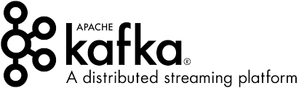
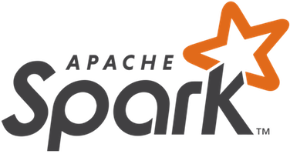
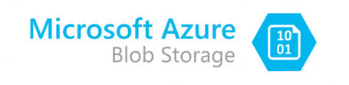
Unified solution and security controls
Cloud SOC solution architecture
Defense in Depth managed service
Physical security
Access controls
Logging and monitoring
Host hardening
Patching
Vulnerability scanning
SDLC
Penetration testing
Risk modeling
SSO
RBAC
Audit logs
Data encryption
Data governance
Backups (data and systems)
https://databricks.com/databricks-enterprise-security
https://azure.microsoft.com/en-us/services/databricks/

Slide 13
Summary
Hybrid layered SOC benefits the most in the Cloud
Dynamic provisioning is leveraged for scalability required for data streaming, storage, and processing
Unified management and security for infrastructure, platforms and software reduces administration overhead
Managed integration and optimization facilitates leveraging new technologies such as machine learning, advanced data analytics and visualization
Full time security staff can focus on security governance, risk intelligence, compliance, information assurance and incident response coordination

Slide 14



Q & A
https://cybersymbiosis.com/
vpolic@cybersymbiosis.com
https://ch.linkedin.com/in/viktor-polic-891a1a145
https://twitter.com/ViktorPolic

